Slide 1






Slide 2

Module 7
Content and knowledge Management

Slide 3
Objectives
To provide basic concepts and knowledge of Content Management to CIOs and explore the applicability of the knowledge gained in the context of E-Government Programme of the Government of Iraq.

Slide 4
What is Content
What is Content Management
knowledge Management
Content Management Standard
CMS and ECMS

Slide 5
Defining Content
  Content is a resource
  Content
      articles
      reports
      pictures
      audio
      Email

Slide 6
What is Content Management
Create the content
Store the content
Retrieve the content
Publish the content
Archive the content
Manage the content end - to - end

Slide 7
Enterprise Content Management in Governments
Why is ECM Important?
Benefits of ECM
  Cost Saving
  Better Citizen Services
  Better Citizen Participation

Slide 8
Components of ECMS
Document Management System
COLLABORATION
Web Content
Management
ECMS
Digital
Asset
Management
Enterprise Information Portal

Slide 9
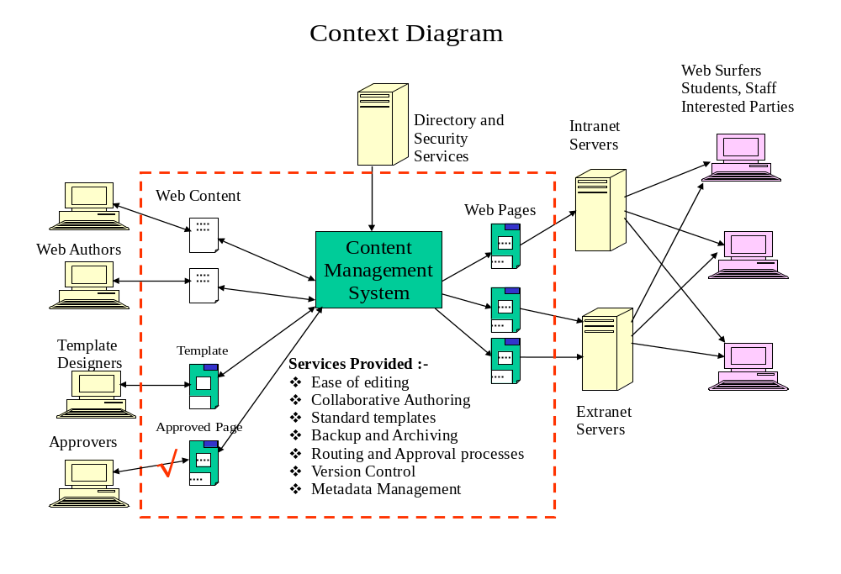
WEB CONTENT

Slide 10

Document Management
Physical Document
Digitization
Document
Creation
Document Flow
Work Flow
Document Retrieval
Document Repository
Document Archive

Slide 11
Meta Data
What is Meta data
Why is it important for CM
Metadata Standards- Dublin Core

Slide 12






A workflow with Metadata
Author
Creates
Content
Approver checks
Work
CMS applies
Metadata
Not Approved
Approved
CMS publishes to
the web servers
Available on the web
Metadata sent to the Search Engine

Slide 13
Metadata standards
Anglo-American Cataloguing Rules (AACR)
Encoded Archival Description (EAD)
Learning Object Metadata (LOM)
Spectrum standard for museum information
Friend of a Friend (FOAF) and vCard
e-Government Metadata Standard (eGMS)
Dublin Core - lowest common denominator

Slide 14
Dublin Core Metadata Element Set
1 | Title
2 | Subject
3 | Description
4 | Type
5 | Source
6 | Relation
7 | Coverage
8 | Creator
9 | Publisher
10 | Contributor
11 | Rights
12 | Date
13 | Format
14 | Identifier
15 | Language

Slide 15

Domain specific metadata
Record Keeping
Dublin Core
CLF
Portal Administration

Slide 16
Controlled Government Vocabulary
Provides a way to organize knowledge for subsequent retrieval.

Slide 17
Controlled Vocabularies
Taxonomies = controlled vocabularies
“Taxonomy”: woolly meaning -> confusion keep it for biological classification systems
Knowledge organization systems (KOS)
a better expression for the general concept
Main types are
  thesauri
  classification schemes
  ontologies

Slide 18








vehicles
road vehicles
conveyances
voitures
388.34
629.2
BT
Choose one term as a descriptor to label the concept:
cars
USE automobiles
NT
cars
automobiles
autos
private cars
388.342
629.222

Slide 19



Preferred Term Substitution
Anything
on farming?
I use the term agriculture for farming, so I’ll search for that

Slide 20



I need information
on road vehicles
I know that buses,cars and lorries are all kinds of road vehicles, so I’ll search for these terms as well as for road vehicles

Slide 21

Please give me information
about agriculture
OK,I’ll look for that. Would you also be interested in items dealing with forestry, livestock or pet breeding?

